Slide 1

Binary Search Treesnary Search Trees
Binary Search Trees
Binary Search TreesBinary Search Trees
Prof. Zhenyu He
Harbin Institute of Technology, Shenzhen

Slide 2








BINARY SEARCH TREES
Binary Search Trees (BSTs) are an important data structure for dynamic sets
In addition to satellite data, elements have:
key: an identifying field inducing a total ordering
left: pointer to a left child (may be NULL)
right: pointer to a right child (may be NULL)
p: pointer to a parent node (NULL for root)
3

Slide 3








BINARY SEARCH TREES
BST property:
key[left(x)] ≤ key[x] ≤ key[right(x)]
Example:
F
B
H
A
D
K
4

Slide 4








INORDER TREE WALK (TRAVERSAL)
What does the following code do?
TreeWalk(x) TreeWalk(left[x]); print(x); TreeWalk(right[x]);
A: prints elements in sorted (increasing) order
This is called an inorder tree walk
Preorder tree walk: print root, then left, then right
Postorder tree walk: print left, then right, then root
5

Slide 5







INORDER TREE WALK
Example:
F
B
H
A D
Output: A B D F H K
How long will a tree walk take?
 Theorem 12.1
K
6

Slide 6







OPERATIONS ON BSTS: SEARCH
Given a key and a pointer to a node, returns an element with that key or NULL:
TreeSearch(x, k)
if (x = NULL or k = key[x]) return x;
if (k < key[x])
return TreeSearch(left[x], k); else
return TreeSearch(right[x], k);
7

Slide 7







BST SEARCH: EXAMPLE
Search for D and C:
F
B
H
A
D
K
8

Slide 8







OPERATIONS ON BSTS: SEARCH
Here's another function that does the same:
TreeSearch(x, k)
while (x != NULL and k != key[x]) if (k < key[x])
x = left[x]; else
x = right[x]; return x;
Which of these two functions is more efficient?
9

Slide 9







OPERATIONS OF BSTS: INSERT
Adds an element x to the tree so that the binary search tree property continues to hold
The basic algorithm
Like the search procedure above
Insert x in place of NULL
10

Slide 10







BST INSERT: EXAMPLE
Example: Insert C
F
B
H
A
D
K
C
11

Slide 11







BST SEARCH/INSERT: RUNNING TIME
The height of a binary search tree is h
What is the running time of TreeSearch() or TreeInsert()?
O(h)
What is the height of a binary search tree?
Worst case: h = O(n) when tree is just a linear string of left or right children
12

Slide 12





Minimum of BST
Maximum of BST
TREE-Minimum(x) 1 while left(x)≠NIL
2 do x←left[x]
3 Return x
TREE-Maximum(x) 1 while right(x)≠NIL
2 do x←right[x]
3 Return x
13

Slide 13







BST OPERATIONS: SUCCESSOR
The successor of the current node is the one in the in- order tree walk.
Two cases:
x has a right subtree: successor is minimum node in right subtree
x has no right subtree: successor is lowest ancestor of x whose left child is also one ancestor of x
(every node is its own ancestor)
Intuition: As long as you move to the left up the tree, you’re visiting smaller nodes.
14

Slide 14


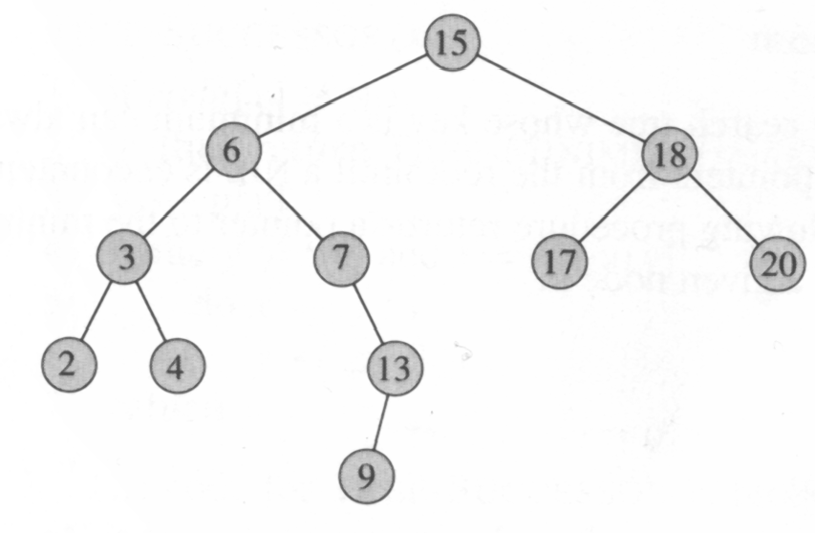





BST OPERATIONS: SUCCESSOR
What is the successor of node 3? 15? 13? 17?
How about predecessor?
15

Slide 15






BST OPERATIONS: DELETE
Deletion is a bit tricky
3 cases:
 x has no children:
F
B
H
Remove x
A
D
K
x has one child:
Splice out x
Example: delete K
C
or H or B
x has two children:
Swap x with successor
Perform case 1 or 2 to delete it
16

Slide 16



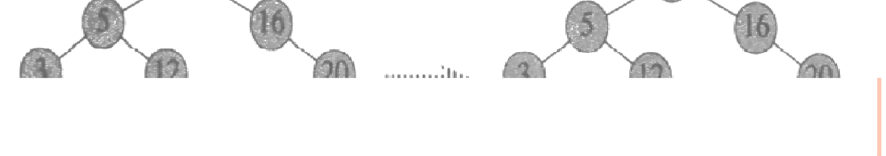

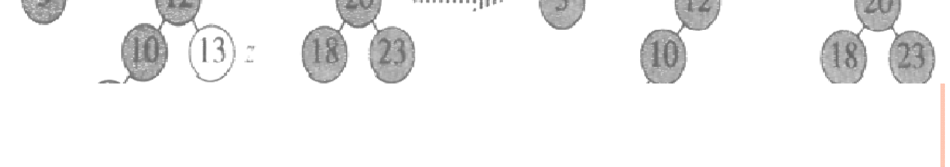

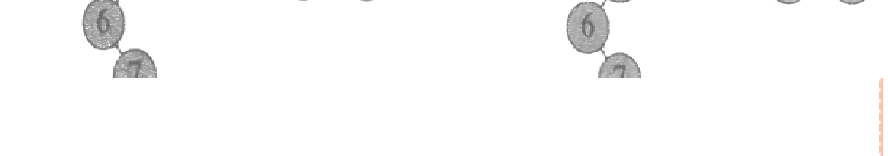


Z HAS NO CHILDREN
17

Slide 17




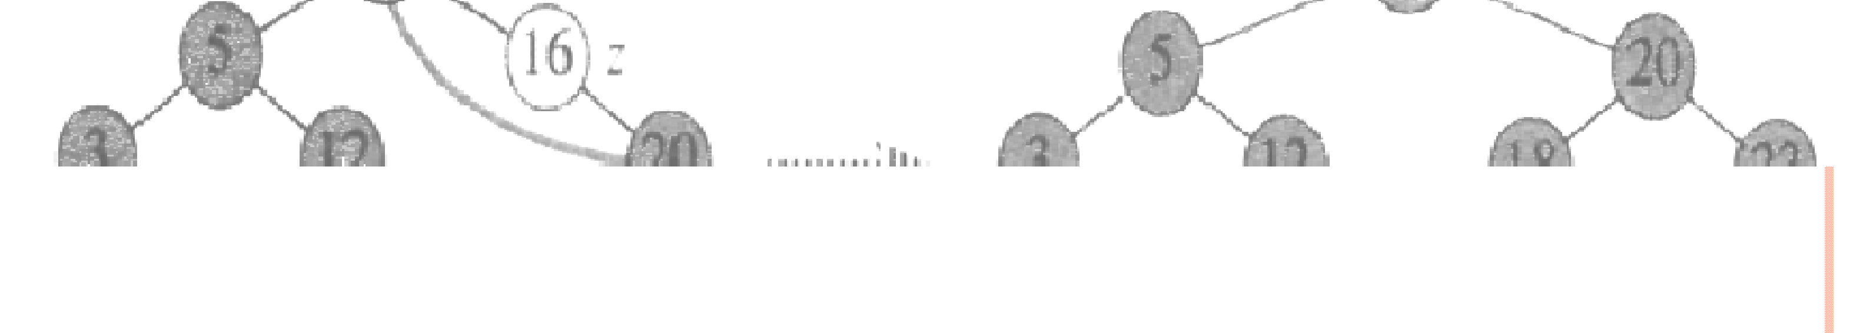






Z HAS ONLY ONE CHILD
18

Slide 18
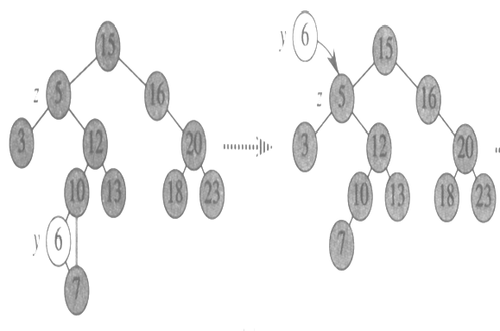
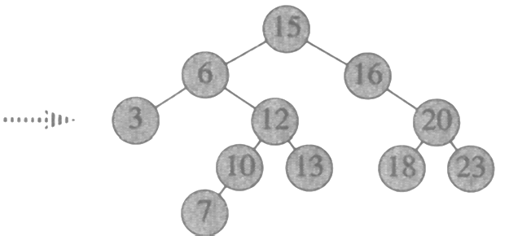
Z HAS TWO CHILDREN
19

Slide 19
BST OPERATIONS: DELETE
Why will case 2 always go to case 0 or case 1?
When x has 2 children, its successor is the minimum in its right subtree.
Could we swap x with predecessor instead of successor?
Yes.
20

Slide 20
SORTING WITH BINARY SEARCH TREES
Can you come out an algorithm for sorting by BST?
3 1 8 2 6 7 5
21

Slide 21
SORTING WITH BINARY SEARCH TREES
Informal code for sorting array A of length n:
BSTSort(A)
for i=1 to n
TreeInsert(A[i]);
InorderTreeWalk(root);
What will be the running time in the
Worst case?
Best case?
Average case?
22

Slide 22

SORTING WITH BSTS
Average case analysis
 It’s a form of quicksort!
for i=1 to n
TreeInsert(A[i]); InorderTreeWalk(root);
3 1 8 2 6 7 5
3
1 2
8 6 7 5
1
8
2
6 7 5
2
6
5
7
5
7

Slide 23
SORTING WITH BSTS
Inserted nodes are similar to partition pivot used in quicksort, but in a different order.
 BST does not partition immediately after picking the inserted node.

Slide 24
SORTING WITH BSTS
Since run time is proportional to the number of comparisons, same time as quicksort: O(n lg n)
Which do you think is better, quicksort or BSTSort? Why?

Slide 25
SORTING WITH BSTS
Since run time is proportional to the number of comparisons, same time as quicksort: O(n lg n)
Which do you think is better, quicksort or BSTSort? Why?
Quicksort
Sorts in place
Doesn’t need to build data structure

Slide 26
MORE BST OPERATIONS
BSTs are good for more than sorting. For example, can implement a priority queue
What operations must a priority queue have?
Insert
Minimum

Slide 27
Randomly Built Binary Search Tree

Slide 28


DEFINITION
A randomly built binary search tree on n keys as one that arises from inserting the keys in random order into an initially empty tree, where each of the n! permutations of the input keys is equally likely.

Slide 29
RANDOMLY BUILT BINARY SEARCH TREE
Theorem: The average height of a randomly-built binary search tree of n distinct keys is O(lg n)
Corollary: The dynamic operations Successor, Predecessor, Search, Min, Max, Insert, and Delete all have O(lg n) average complexity on randomly-built binary search trees.

Slide 30
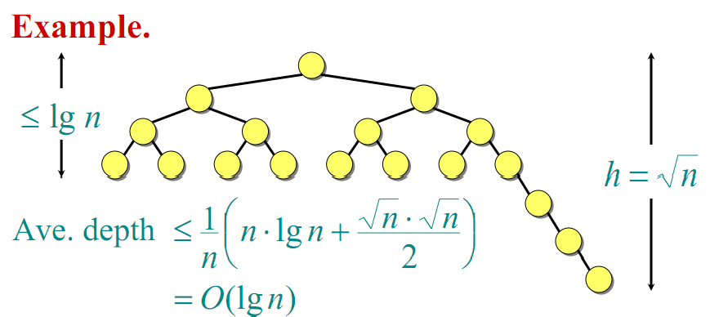
EXPECTED TREE HEIGHT
Average node depth of a randomly built BST = O(lg n) does not necessarily mean that its expected height is also O(lg n) (although it is).

Slide 31
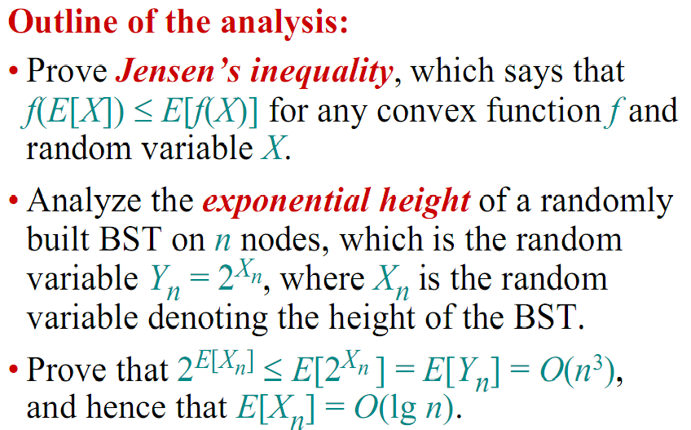
HEIGHT OF A RANDOMLY BUILT BINARY SEARCH TREE

Slide 32
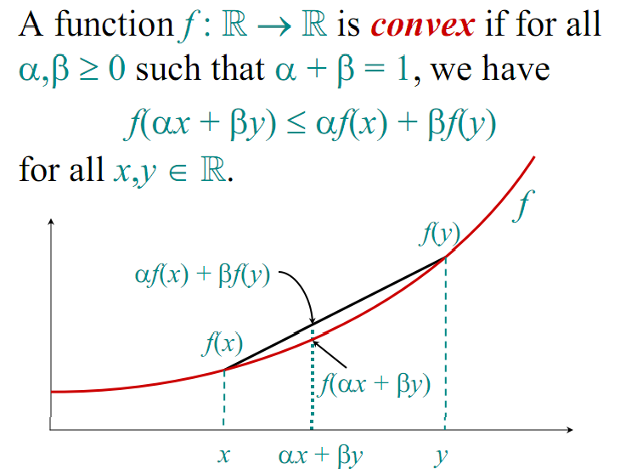


CONVEX FUNCTIONS

Slide 33
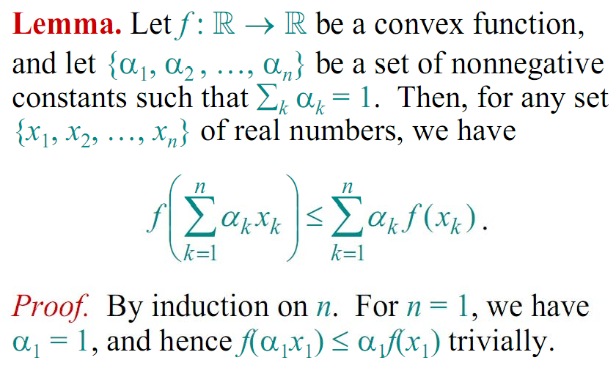


CONVEXITY LEMMA

Slide 34
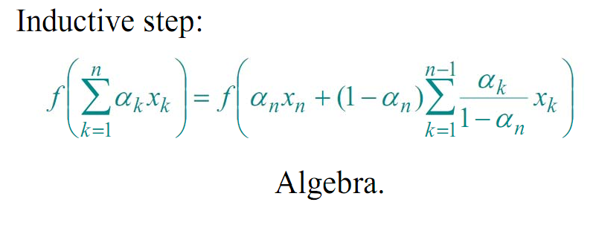
PROOF (CONTINUED)

Slide 35
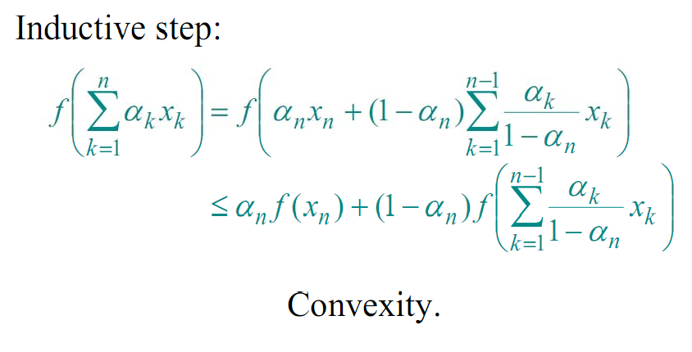
PROOF (CONTINUED)

Slide 36
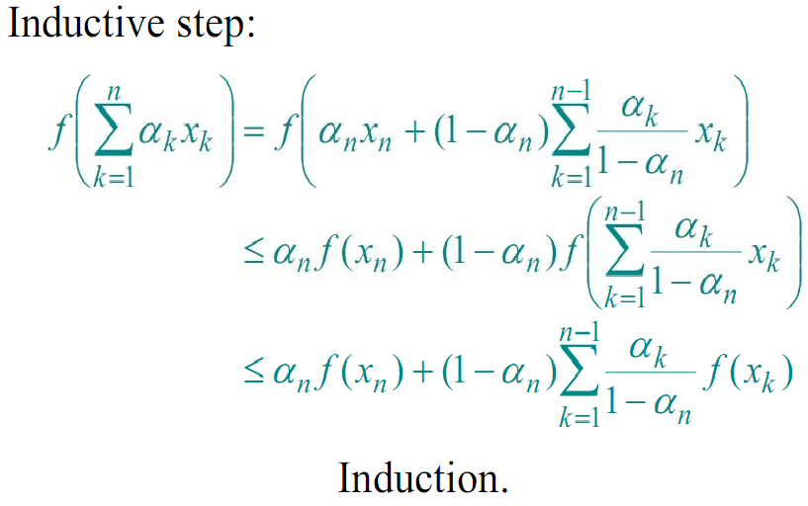
PROOF (CONTINUED)

Slide 37
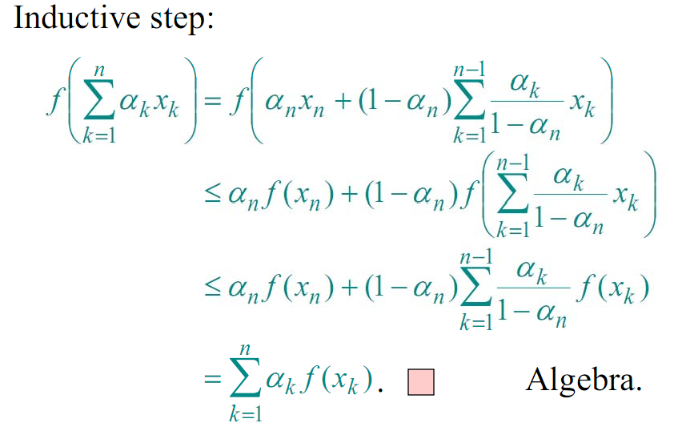
PROOF (CONTINUED)

Slide 38
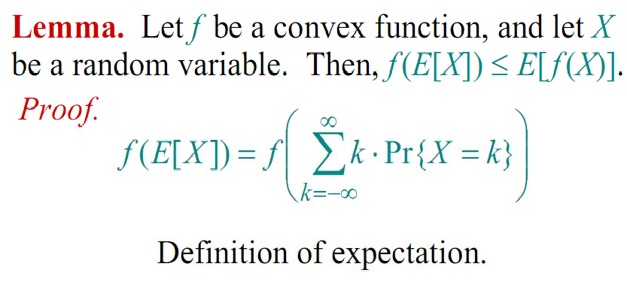
JENSEN’S INEQUALITY

Slide 39
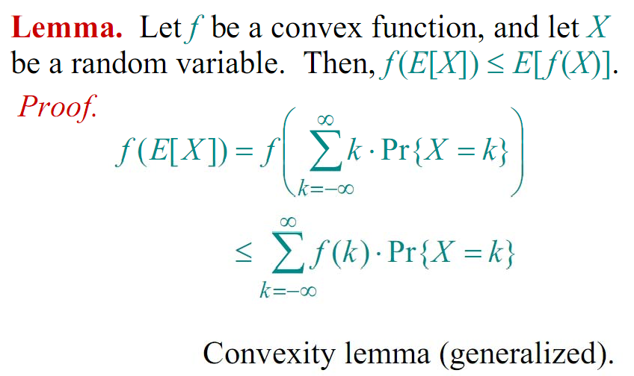
JENSEN’S INEQUALITY

Slide 40
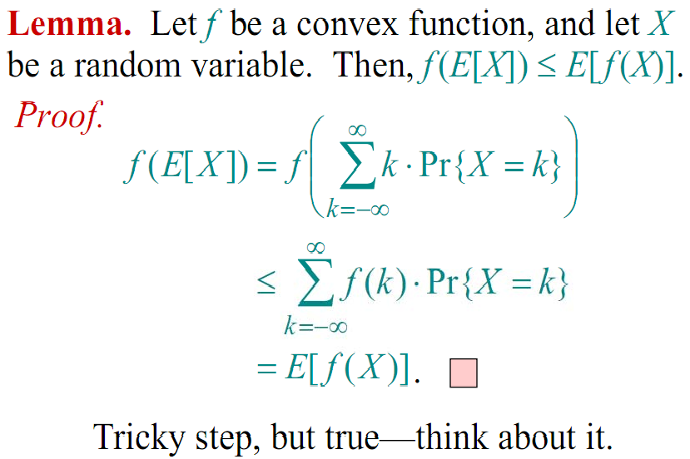
JENSEN’S INEQUALITY

Slide 41
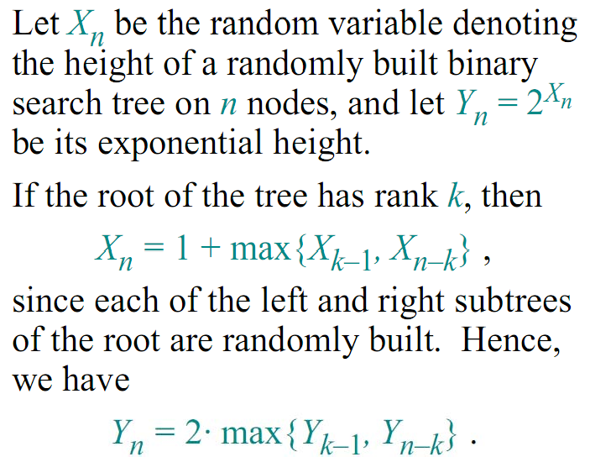
ANALYSIS OF BST HEIGHT

Slide 42
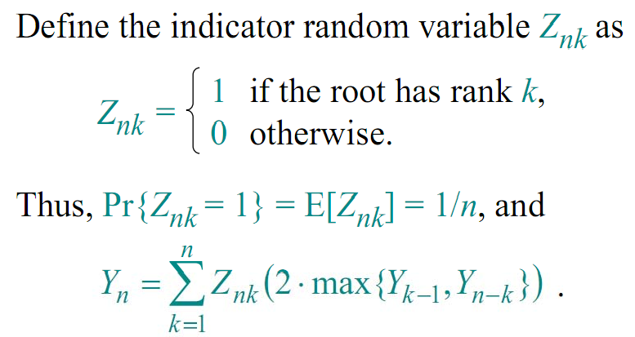
ANALYSIS (CONTINUED)

Slide 43
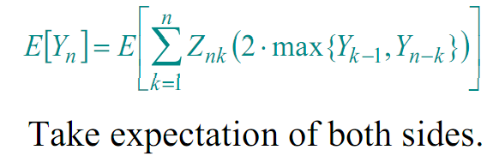
EXPONENTIAL HEIGHT RECURRENCE

Slide 44
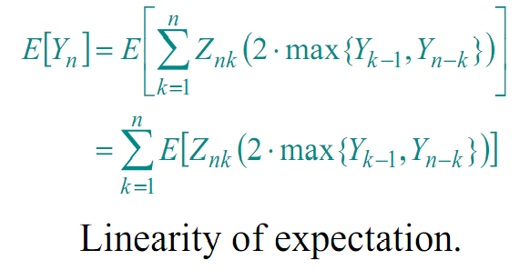
EXPONENTIAL HEIGHT RECURRENCE

Slide 45
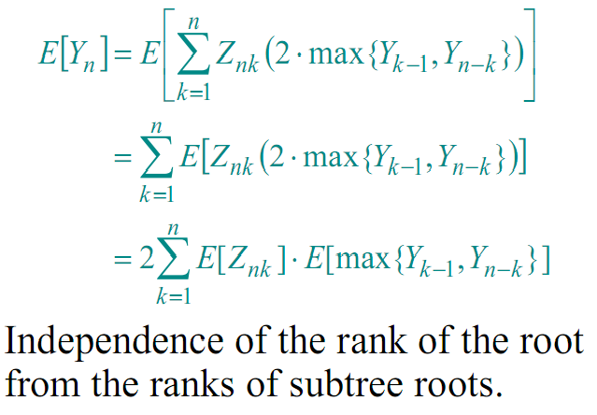
EXPONENTIAL HEIGHT RECURRENCE

Slide 46
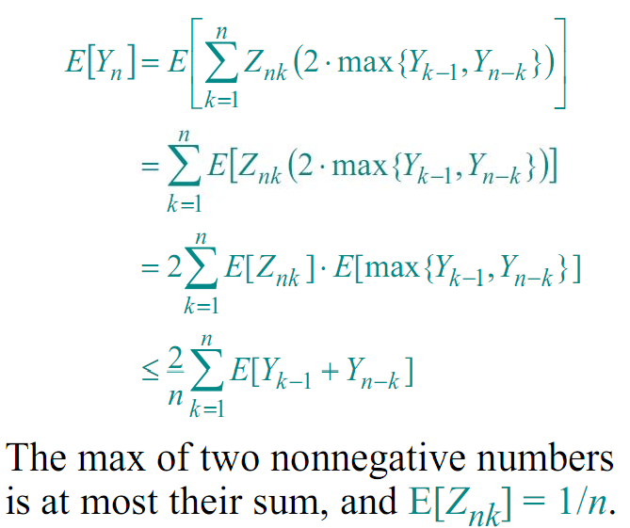
EXPONENTIAL HEIGHT RECURRENCE

Slide 47
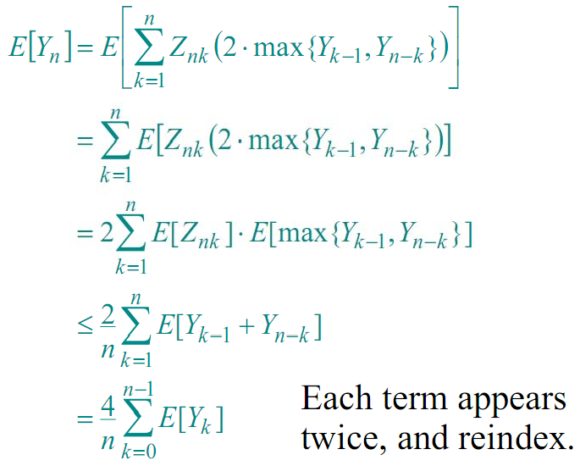
EXPONENTIAL HEIGHT RECURRENCE

Slide 48
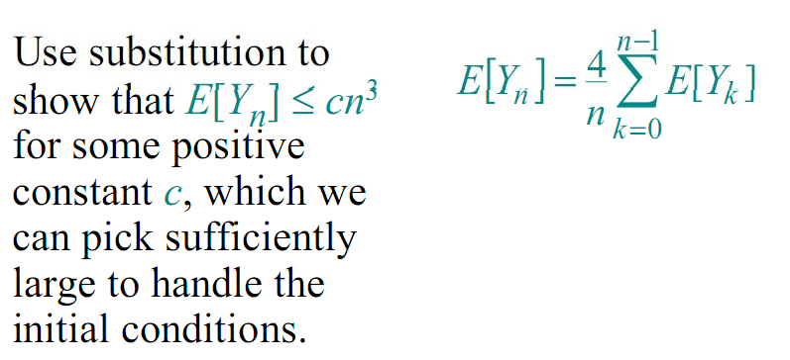
SOLVING THE RECURRENCE

Slide 49
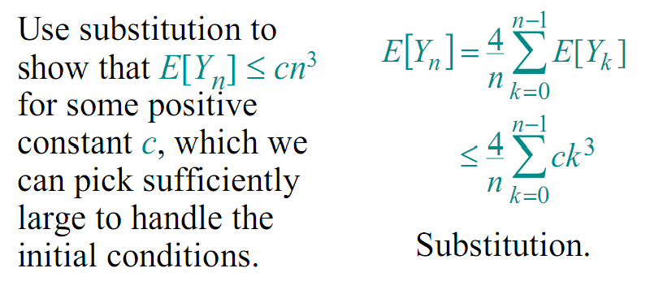
SOLVING THE RECURRENCE

Slide 50
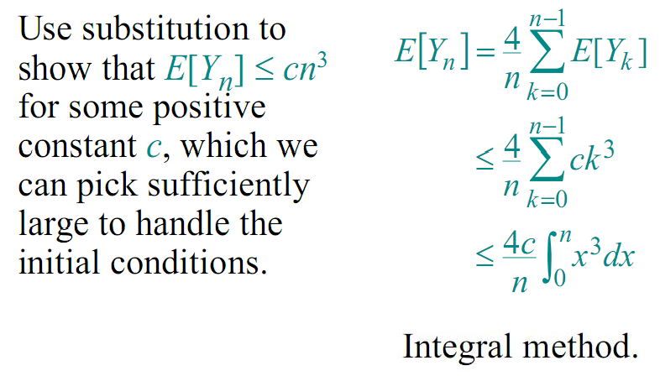
SOLVING THE RECURRENCE

Slide 51
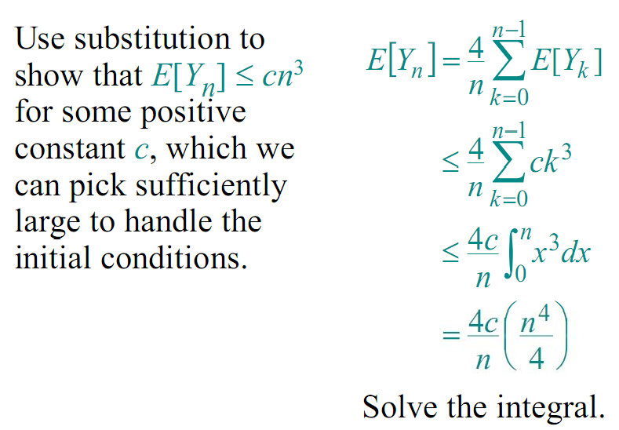
SOLVING THE RECURRENCE

Slide 52
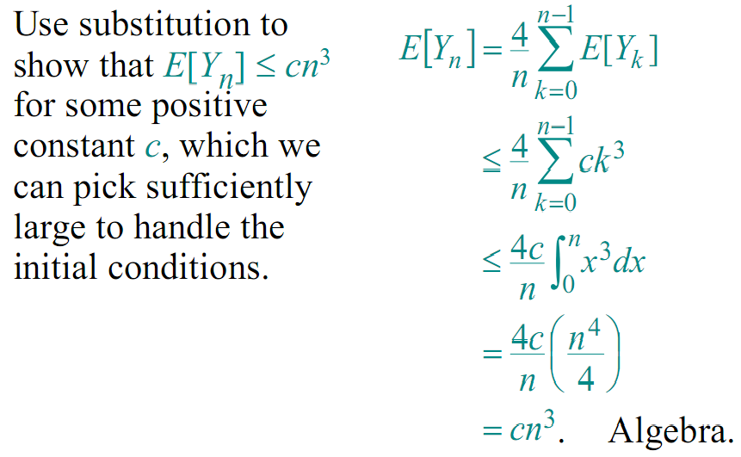
SOLVING THE RECURRENCE

Slide 53
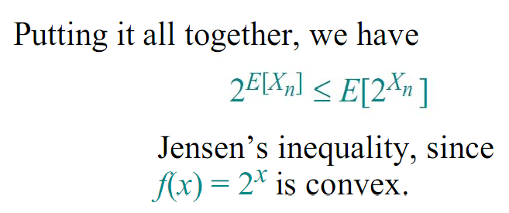
THE GRAND FINALE

Slide 54
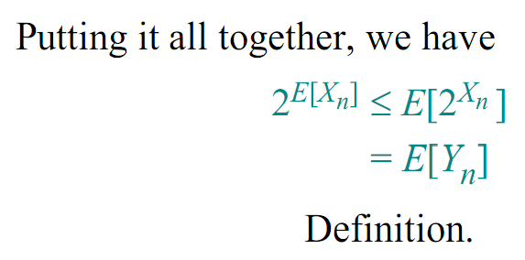
THE GRAND FINALE

Slide 55
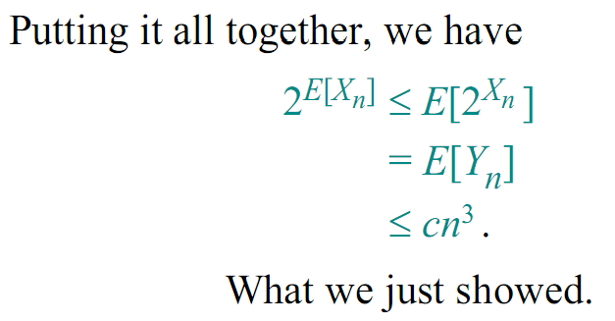
THE GRAND FINALE

Slide 56
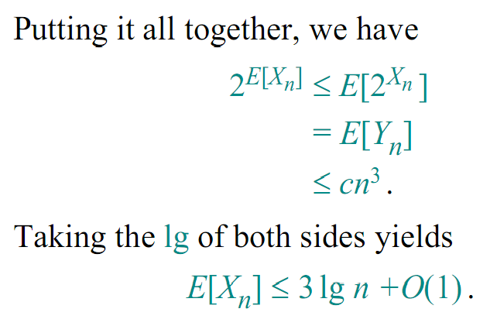
THE GRAND FINALE

